Slide 1

Customer Segmentation Project
Virtual Internship
11 October 2022

Slide 2

Group Name: cust_seg
Specialization: Data Science
Submitted to: Data Glacier
Internship Batch: LISUM 12
Team Member Details:
Brennan Clinch, bclincher98@gmail.com, USA, North Carolina State University, Data Science
Rohit Sunku, rgs8890@gmail.com, UK, Le Wagon, Data Science
Kutay Selçuk, kutay.selcuk@ozu.edu.tr, Turkey, Ozyegin University, Data Science
Zhan Shi, zhanshi@g.ucla.edu, USA, University of California Los Angeles, Data Science
Group Information

Slide 3
XYZ bank wants to roll out Christmas offers to their customers. But Bank does not want to roll out the same offer to all customers. Instead, they want to roll out personalized offers to a particular set of customers. If they manually start understanding the category of the customer then this will be not efficient and also they will not be able to uncover the hidden pattern in the data (pattern which group certain kind of customer in one category). Bank approached ABC analytics company to solve their problem. Bank also shared information with ABC analytics that they don't want more than 5 groups as this will be inefficient for their campaign.
ABC analytics assigned this talk to their analytics team and instructed their team to come up with the approach and feature which group similar behavior in one category and others in a different category.
Problem Description

Slide 4
Total Customers: 1000000
Goal: We want to segment customers based on their behavior. The main things we are interested in for our Exploratory Data Analysis are:
What products are most used by the customers?
What channel has the most amount of customers?
What age range has the most customers? Does the age ranges have an effect on the types of products being bought?
What products are most used based on the seniority of the customer from when they started?
Does the city/province of the customer have an effect on the products that are bought or used?
What effect does gender have on the products being bought?
Income by city, age, seniority, and gender
Data Information and Goals

Slide 5
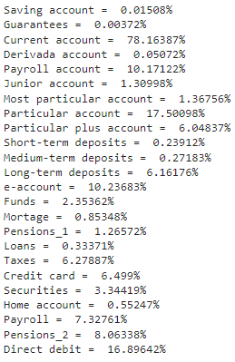
Overall, most customers have a Current Account, but also could have a Particular Account, along with Direct Debit, Payroll, and an e-account.
Product Distribution
Table of overall product distribution

Slide 6

From the table, we see that channel “KAT” is the most popular channel being used by the customers.
Channel Distribution
Table of the 10 most popular channels being used

Slide 7
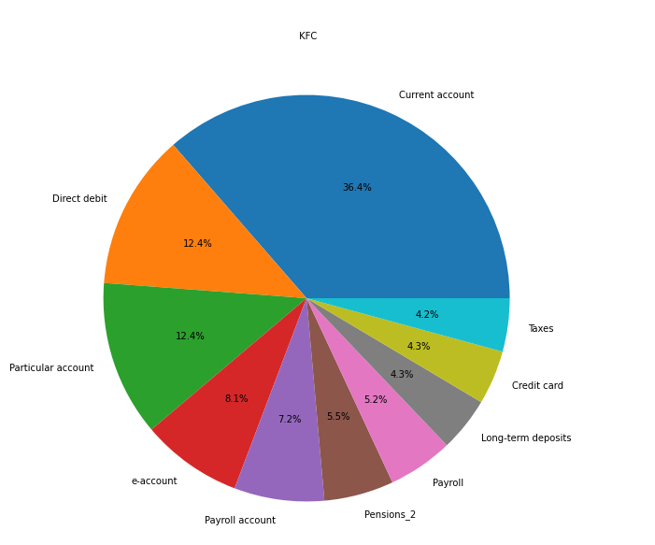
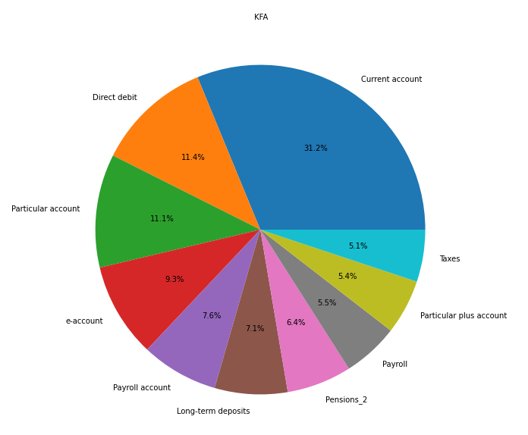
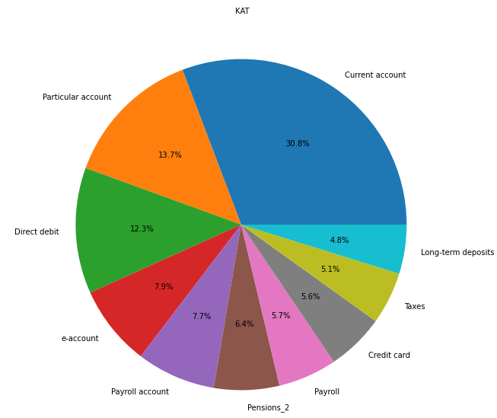
For the distribution of products based on channel, we can see that for the top 3 channels that take up the most amount of data, there is no significant difference of products between customers.
Channel Distribution

Slide 8
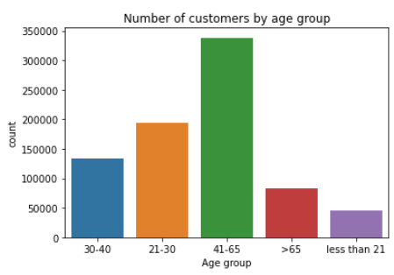
For the general customer distribution, people aged 41-65 make up the biggest portion of total customers.
Age Distribution

Slide 9
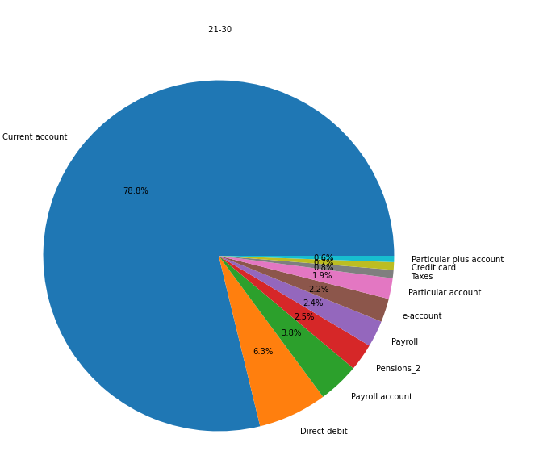
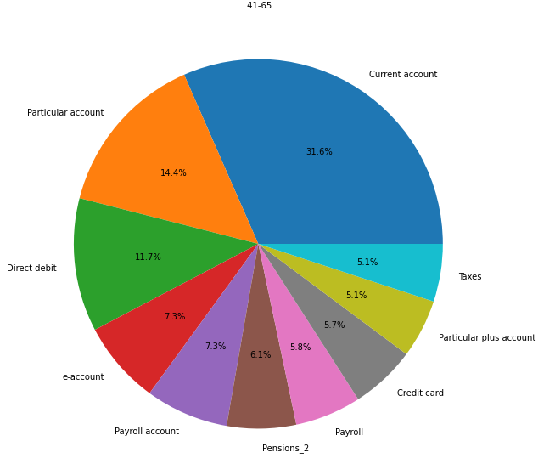
However, customers who are young adults (under 21 and 21-30) make up the biggest proportion of purchases with a Current account compared to those aged 41-65.
Also, not shown here, but a Junior account is a popular product used by those who are under 21.
Age: Product Distribution

Slide 10
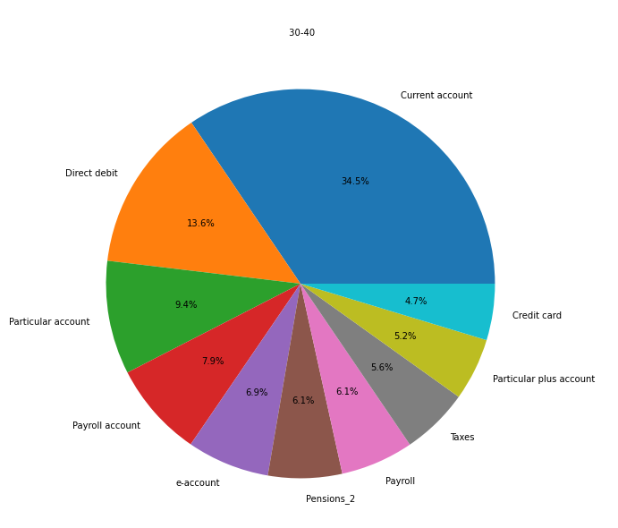
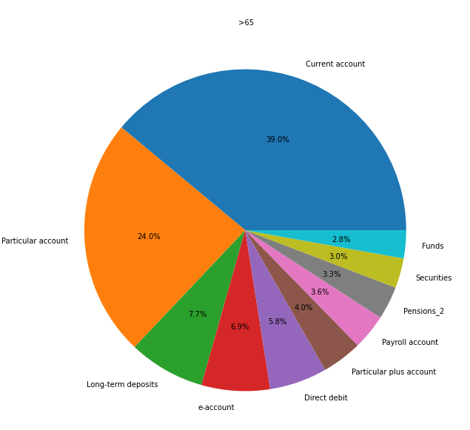
For customers who are over 65, the other most popular account for them is Particular account.
Direct debit is popular among individuals aged 30-40.
Age: Product Distribution

Slide 11
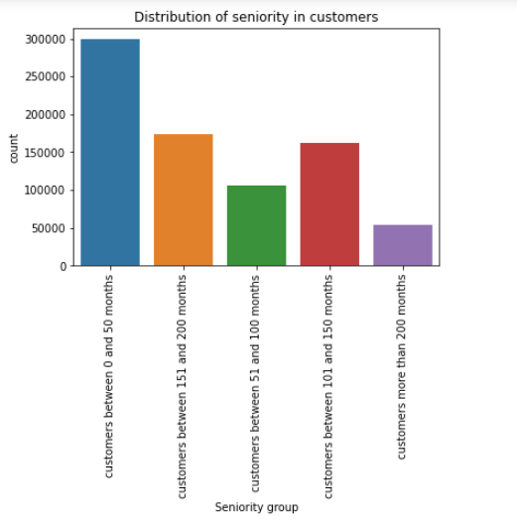
Most customers are brand new, meaning they have been there less than 50 months (or 4 years).
The next popular groups are those who have been at company between 100 and 200 months.
Seniority of customers

Slide 12
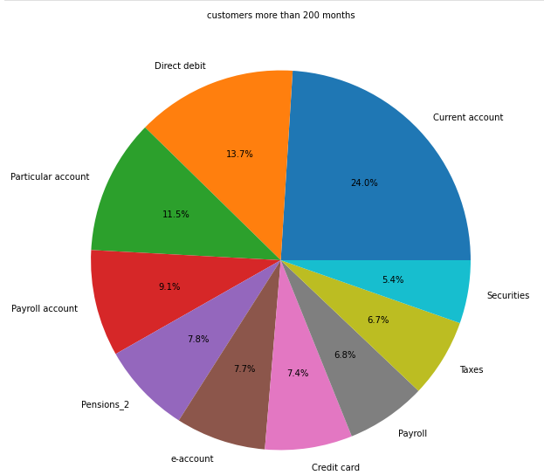
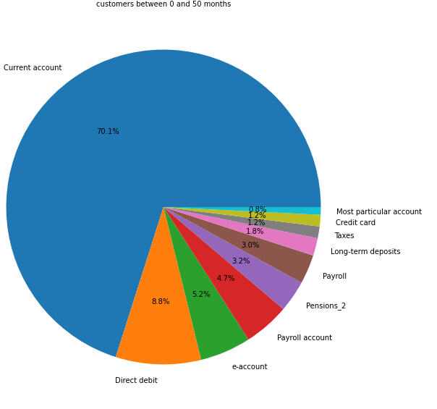
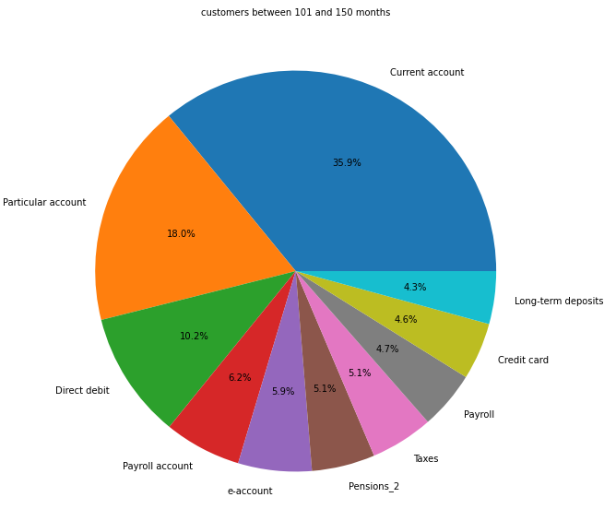
> 200 months
The amount of customers who have a current account decreases as the time they have been a member increases.
Customers who have been there 4 years or less are most likely to have a Current account.
Seniority of customers: Product Distribution
0 and 50 months (~4 years)
101 and 150 months

Slide 13
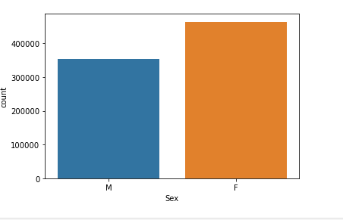
Overall, females are the most popular customer gender.
Customers by gender

Slide 14
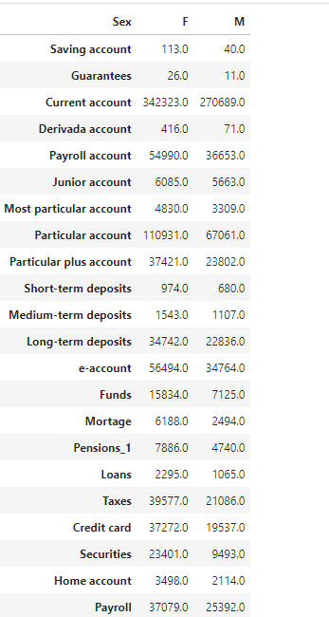
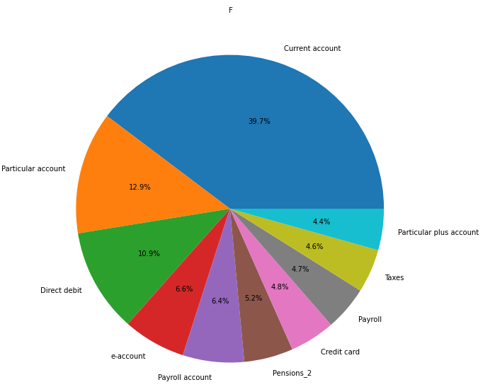
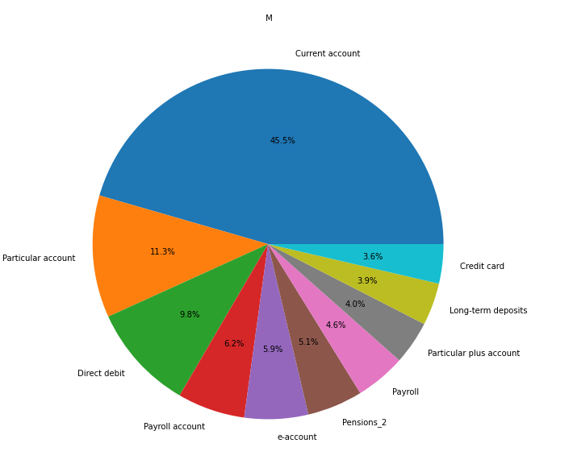
Overall, females have more products than males, but although the difference isn’t significant, there are a little bit more males that have a Current account than females.
Customers by gender: Product Distribution

Slide 15
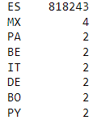
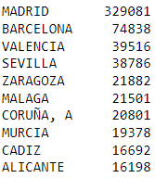
Based on the tables below, we can see that almost all customers are from Spain, along with Madrid being the most popular city/province.
Top countries of customers
Top 10 cities of customers
Customers by country and city

Slide 16
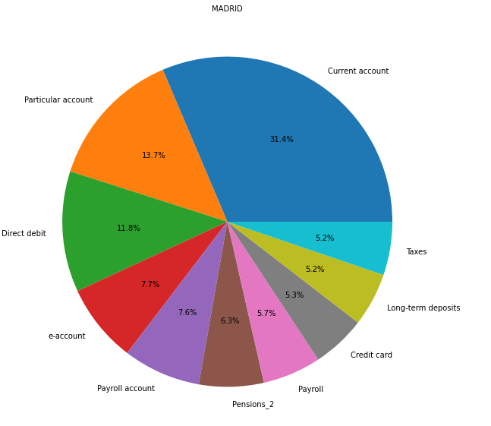
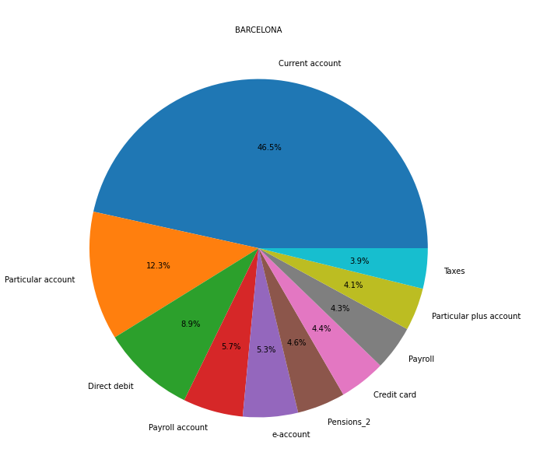
Based on the pie charts, we can see that the city/province can have a significant effect on the product distributions from customers.
Customers by city: Product Distribution

Slide 17
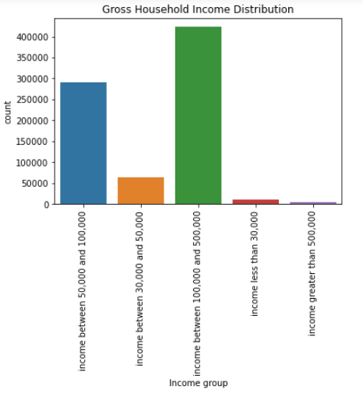
From the Bar graph, we can see that customers usually make between $100,000 and $500,000.
Customers by income

Slide 18
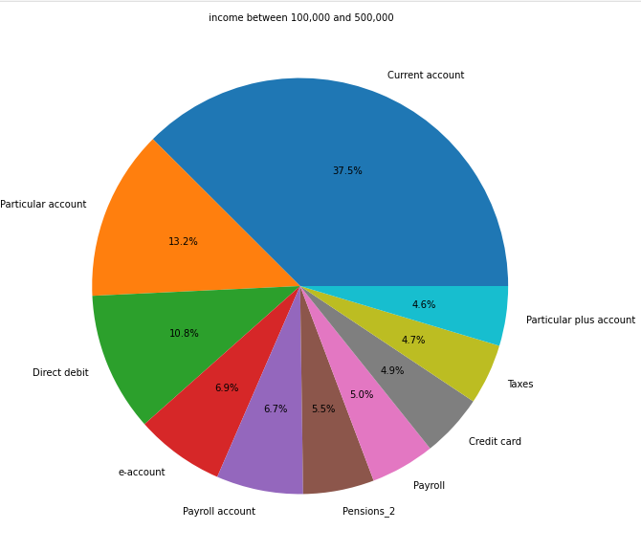
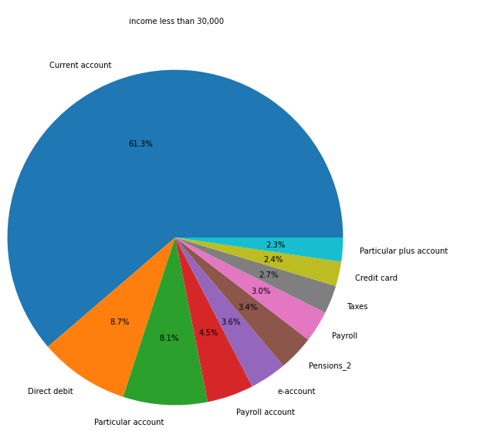
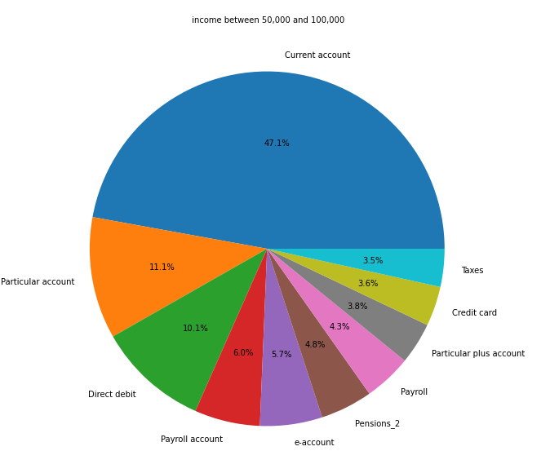
Based on the pie charts, we can conclude that there is a significant difference between the product distributions based on the gross income of customers.
Income between $100k and $500k
Customers by income: Product Distribution
Income less than $30k
Income between $50k and $100k

Slide 19
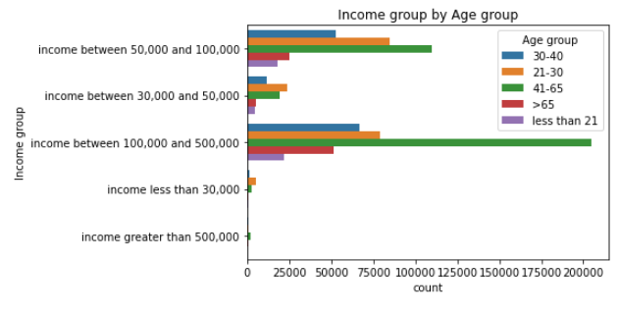
Customers who are young adults (21-30) are most likely to have a gross household income of between $50,000 and $100,000.
Customers who are middle aged (41-65) are more likely to have a gross household income greater than $100,000 but less than $500,000. This would most likely make sense as this age group has been working for a while.
Income by age group

Slide 20
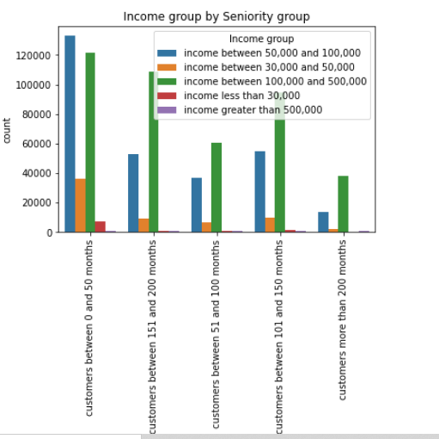
Customers who have gross household income between $50,000 and $100,000 most likely have been a customer for less than 4 years, along with those who have income between $100,000 and $500,000.
Income by seniority

Slide 21
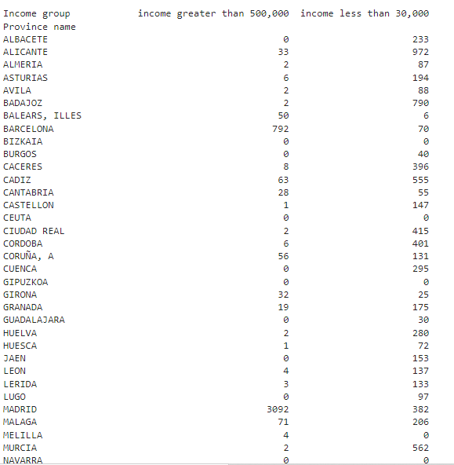
Overall, Madrid was the most popular city by customers for most income groups. However, it was shown that for customers whose gross household income was less than $30,000, other cities had a higher number of customers.
Income by city

Slide 22
In order to segment our customers into 5 groups for our modeling which is the next step we can use the following recommendations to help.
We can focus on ages that are older than 18-30 as that is where most of the customers are.
Males have lower product usage than females, so giving away special offers to males could be a strategy.
Since Spain has the most amount of customers overall (mainly just Spain for the data we have) along with Madrid being the most popular city, the bank can focus on other cities/areas in Spain.
The bank can focus on individuals separately with regards to their seniority with certain offers given to people with middle and higher seniority and then to people with lower seniority.
Final Recommendations

Slide 23
Since we will be working with no dependent variables, we will use unsupervised learning methods for our modeling.
Since we are wanting to divide customers into different groups that share similar product and other demographic behavior in order to break up the groups for special Christmas offers, we will most likely be using clustering, which is when we divide data points up into a certain number of groups so that the data points in same group are similar to the other data points in same group than other groups.
K-Means Clustering: For K-Means Clustering, the goal of this method is to partition n observations into k clusters in which every observation belongs to the cluster with the nearest mean.
Hierarchical Clustering: For Hierarchical Clustering, the goal of this method is build a hierarchy of clusters.
- We will use both methods and compare for validation to finalize our analysis.
Modeling Choices

Slide 24
Thank You

